Slide 1
STARDAT DATA ARCHIVING SUITE
Monika Linne, Evelyn Brislinger, Wolfgang Zenk-Möltgen
European Survey Research Association (ESRA), July 18 – 22, 2011, Lausanne, Switzerland

Slide 2
Overview
Current Situation – Different Archiving Tools
Main Tools – DBKEdit/ DSDM/ CBE
Present and Future
Proceeding
Architectural Requirements
European Value Study - EVS
Benefits of STARDAT

Slide 3
Current Situation – Different Archiving Tools
Online Publication
Offline- and Online Publication
da|ra
DBK
ZACAT
Variable Overview
Report
CBE
Report-Tool
Longterm-preservation
DSDM
DBKEdit
DBKEdit Data Catalogue Edit-Tool
DBK Data Catalogue
ZACAT Online Study Catalogue
da|ra Registration Agency
CBE CodebookExplorer
DSDM Dataset Documentation Manager

Slide 4
Main Tools
1. Data Catalogue Edit-Tool (DBKEdit)
Documentation and management of metadata on study level of all archived studies
Inhouse-tool
Web-based
DDI-supporting (Export to DDI 2.0)
Information provided
For each study (partly bi-lingual):
Title & study number
Primary investigators & fieldwork agencies
Universe & sampling
Abstracts
Related publications
Questionnaires
Notes and comments for internal use
Publication via
- ZACAT (Nesstar)
CBE (CodebookExplorer)
DBK (Data Catalogue)

Slide 5
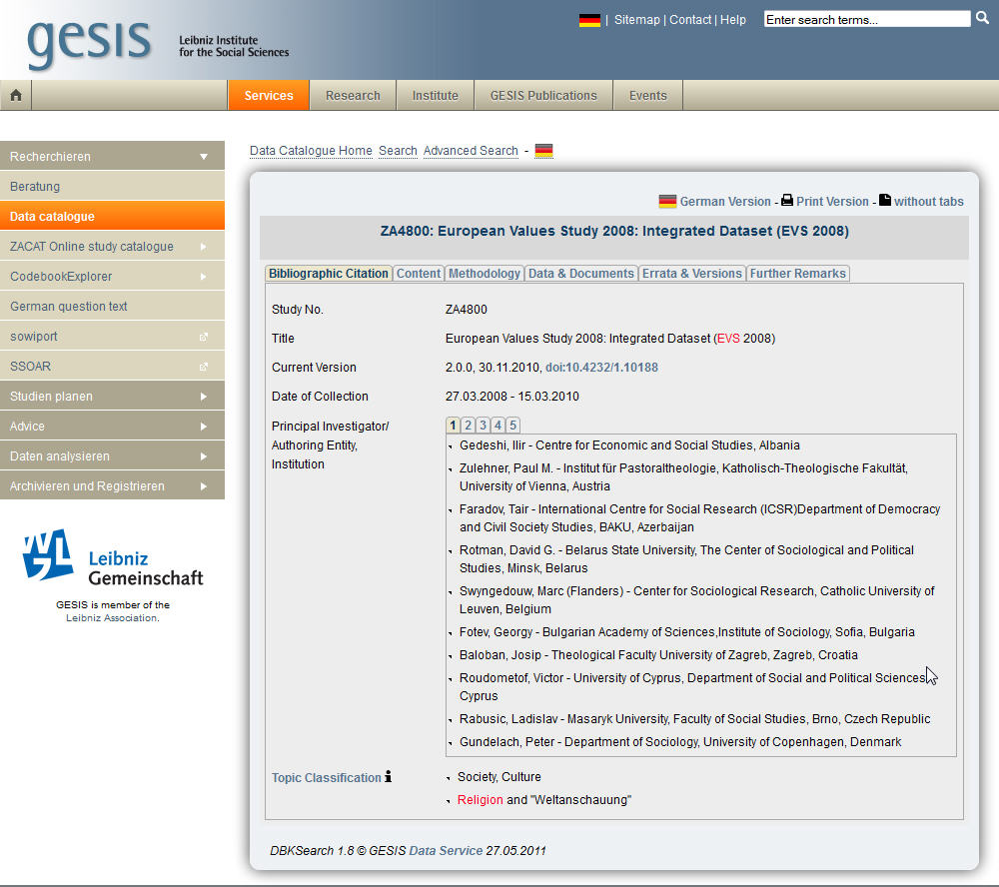
DBKEdit – Publication e.g. via DBKSearch and da|ra

Slide 6
Main Tools
2. Dataset Documentation Manager (DSDM)
Documentation of metadata on variable-level for special datasets and data collections
A. Inhouse-tool & external projects
B. ACCESS-based desktop-application
C. DDI-supporting (Export to DDI 2.0 and 3.1)
Information provided
For each Variable:
Exact question and answer texts
Multilingual documentation
Documentation of deviations in questionnaires fielded in different waves or countries
Interviewer instructions
Forward/backward instructions for filter questions
Documentation of additional archival notes (e.g. recoding, deviations)
Generating variable categories
Publication via
- ZACAT (Nesstar)
- CodebookExplorer
Notes:
Überschrift Position 1,39 – 3,37

Slide 7
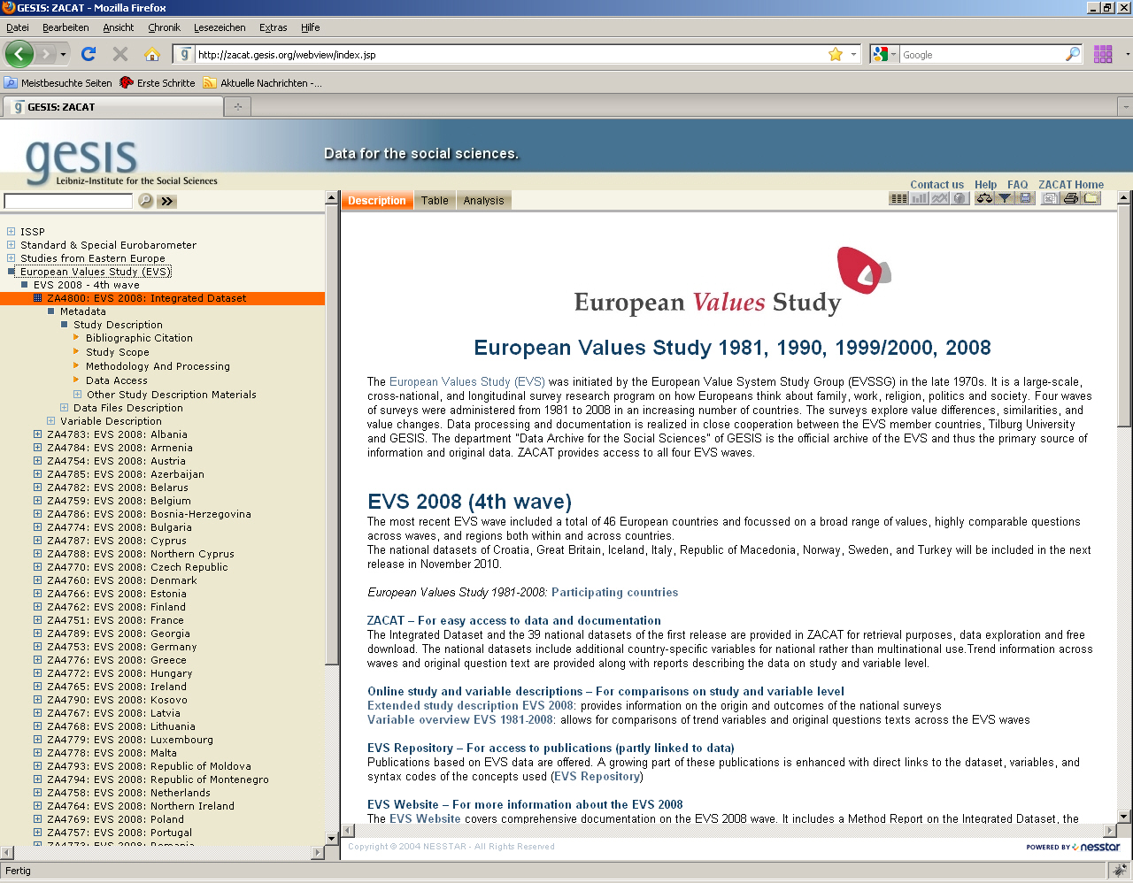
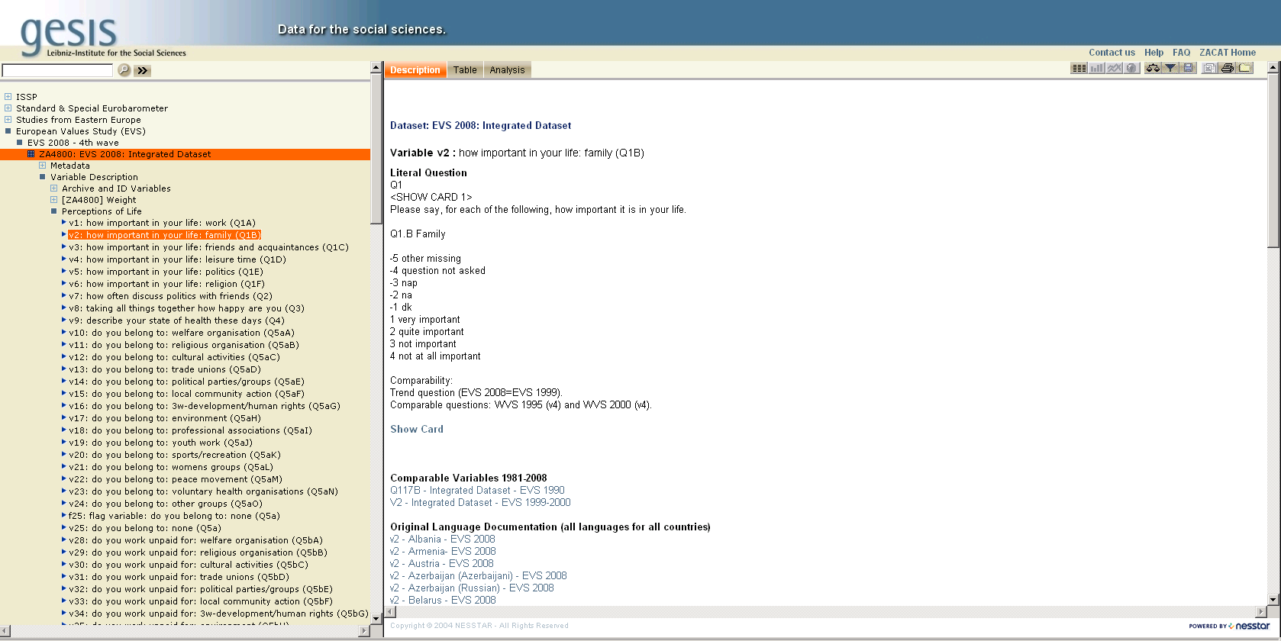
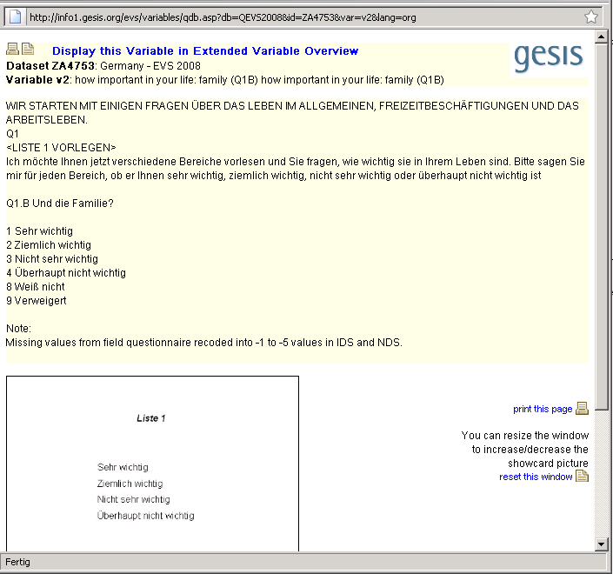
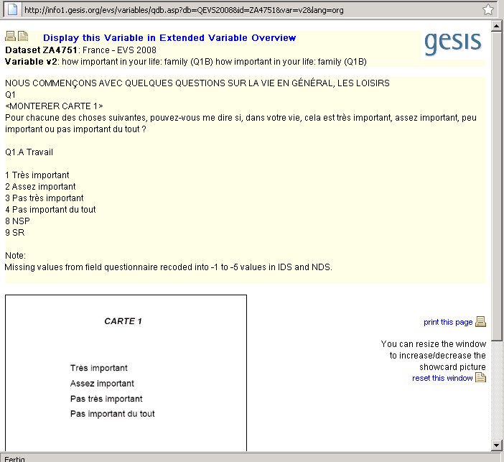
DSDM → Publication via ZACAT
Notes:
Überschrift Position 1,39 – 3,37

Slide 8
Main Tools
3. CodebookExplorer (CBE)
Tool on context-level which gives easy retrieval possibilities to end-users for databases of specific topics, relations and structure of variables
Tool for end-users
Inhouse-tool supporting the publication of context
information (e.g. comparable questions, show cards)
C. Not DDI-supporting
Information provided
For each study/data set
Browsing studies or trends, topics, scales etc.
Structuring of variables according to content or methodical aspects
Comparison of question texts and Show Cards
First analysis like frequencies or crosstabs
Questionnaires
Access to SPSS datasets
Publication via
- CodebookExplorer
ZACAT
Online Variable Overview
Reports

Slide 9
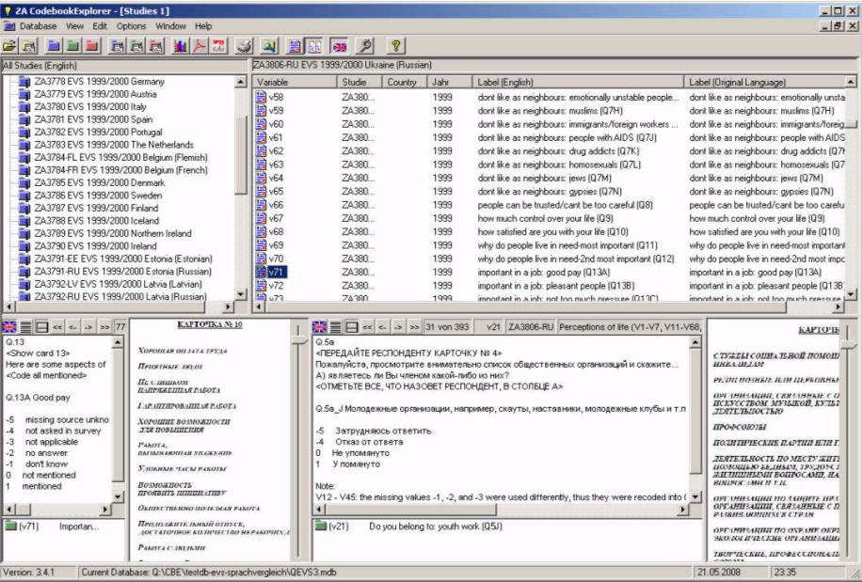
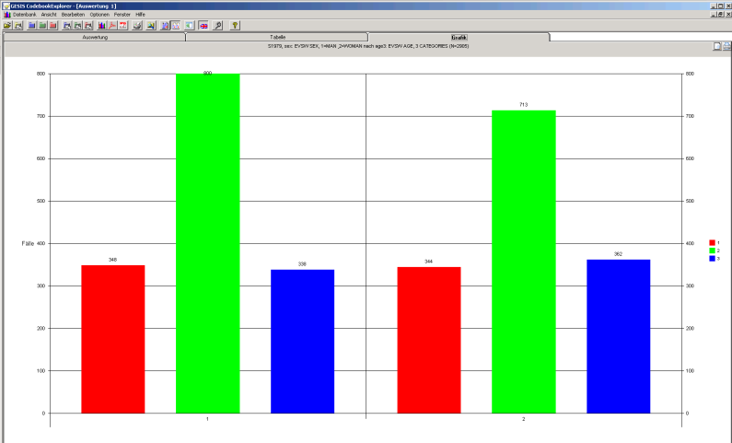
CBE → Publication and Management via CD-ROM and Internet

Slide 10
The Present – Coming from here…
Online Publication
Offline- and Online Publication
da|ra
DBK
ZACAT
Variable Overview
Report
CBE
Report-Tool
Longterm-preservation
DSDM
DBKEdit
DBK Data Catalogue
ZACAT Online Study Catalogue
DBKEdit Data Catalogue Edit-Tool
DSDM Dataset Documentation Manager
CBE CodebookExplorer
da|ra Registration Agency

Slide 11
The Future – Going to there…
Online Publication
Offline- and Online Publication
da|ra
DBK
ZACAT
Variable Overview
Report
CBE
STARDAT
Longterm-preservation
STARDAT - The Data Archiving Suite
Integrated management system for metadata
Transfer of the features of DBKEdit, DSDM, CBE and further tools
Interoperability with standards like DDI 2, DDI 3, ISCO, ISCED
Multi-language documentation on study and variable-level
Controlled vocabularies (Thesauri)
Related publications, scales, trends and additional metadata
Web based modul for structured metadata capture, management and dissemination (Web Based Data Ingest)
Export in different portals like ZACAT, Cessda Data Portal, Sowiport, da|ra
Longterm-preservation with DDI

Slide 12
Proceeding
Requirements analysis - structured interviews with the main stakeholders
Transfer of the results in use-cases
UML-Models of the workflows
Defining system architecture
Experimental prototyping
Paper-prototyp based on the functionalities of DBKEdit
User tests with paper-prototyp
Building of working prototyp
Evaluation of prototyp with users
Implementation of full functionality

Slide 13
Architectural Requirements
Browser-based web application
Transaction-based multi-user access
Distributed undo-/redo-mechanism
Automation of repeatable tasks with scripting engine
Multithreading
Autocomplete
Extensible framework for further needs of metadata documentation

Slide 14
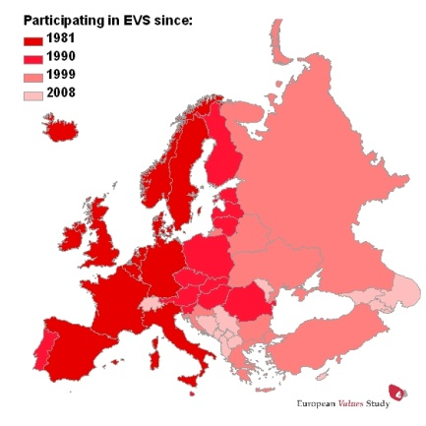
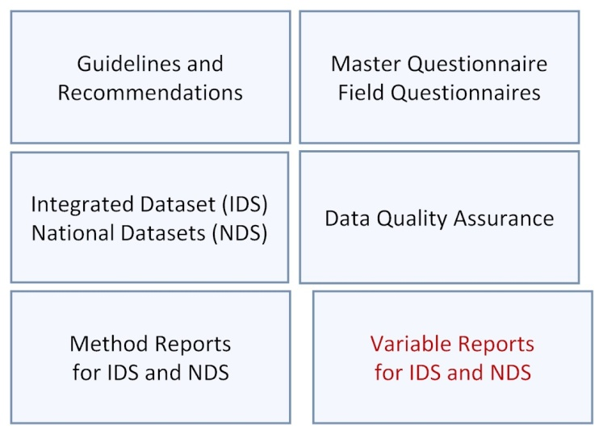
European Values Study 2008
http://www.europeanvaluesstudy.eu/
Study level and variable level documentation
Technical reports
Online retrieval systems (ZACAT; DBKSearch)
Interactive online overviews
47 countries/regions (38 languages/65 versions)
Linked translation and documentation process
English and multilingual documentation
Transparency and easy access
Long-term preservation for next EVS wave
Notes:
Let’s get started with a brief look at the EVS
- It’s carried out under the responsibility of the European Values Study Foundation and started in 1981 with a value survey in 13 countries.
- Since then, surveys have been conducted in 1990 in 30 countries, in 1999 in 33 countries, and in the most recent wave in 47 countries/regions.
In EVS 2008, 38 main languages and altogether 65 language versions (shared languages adapted to the cultural context of the country) were fielded.
For translation the English master qustionnaire a standardised translation procedure has been designed by the EVS team/CEPS Luxembourg and Gallup Europe and closely connected to the data archive’s documentation workflow.
We pursued three main goals:
To create a workflow which makes sure that the translation procedure and the documentation process support each other on the long run.
To provide a high degree of transparency regarding the workflow and easy access to the results for secondary users,
- To preserve and maintain all key information of the different stages in a suitable form so they can be used to improve the EVS from wave to wave.
---
Documentation
Guidelines and Recommendations includes the standards and recommendations for questionnaire translation and fieldwork, weighting etc. designed by the EVS advisory groups for all EVS member countries.
Method Report gives summarized information on the Integrated Dataset with country-specific information on the origin of the national datasets, based on the methodological questionnaires (questionnaire translation and fieldwork, weighting etc.) submitted by all EVS member countries.
Variable Report Integrated dataset: combines variable descriptions of the Integrated Dataset with question texts of the English Master Questionnaire and Show cards.
The bilingual (English language/original language) variable reports combine variable descriptions of the national datasets with the question texts of the English Master Questionnaire as well as the original question texts of the field questionnaires.
‘Report Data quality assurance’ provide insights into the origin of the data and documentation, the decisions made, the workflows designed and tools used in the course of the study.

Slide 15
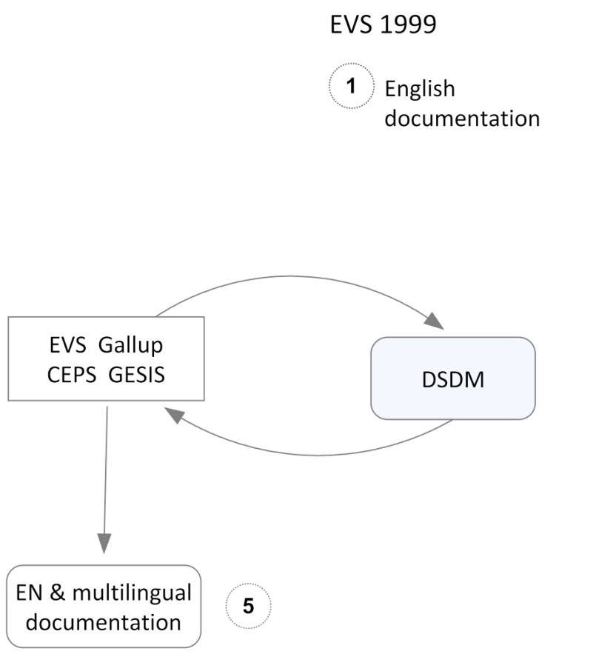
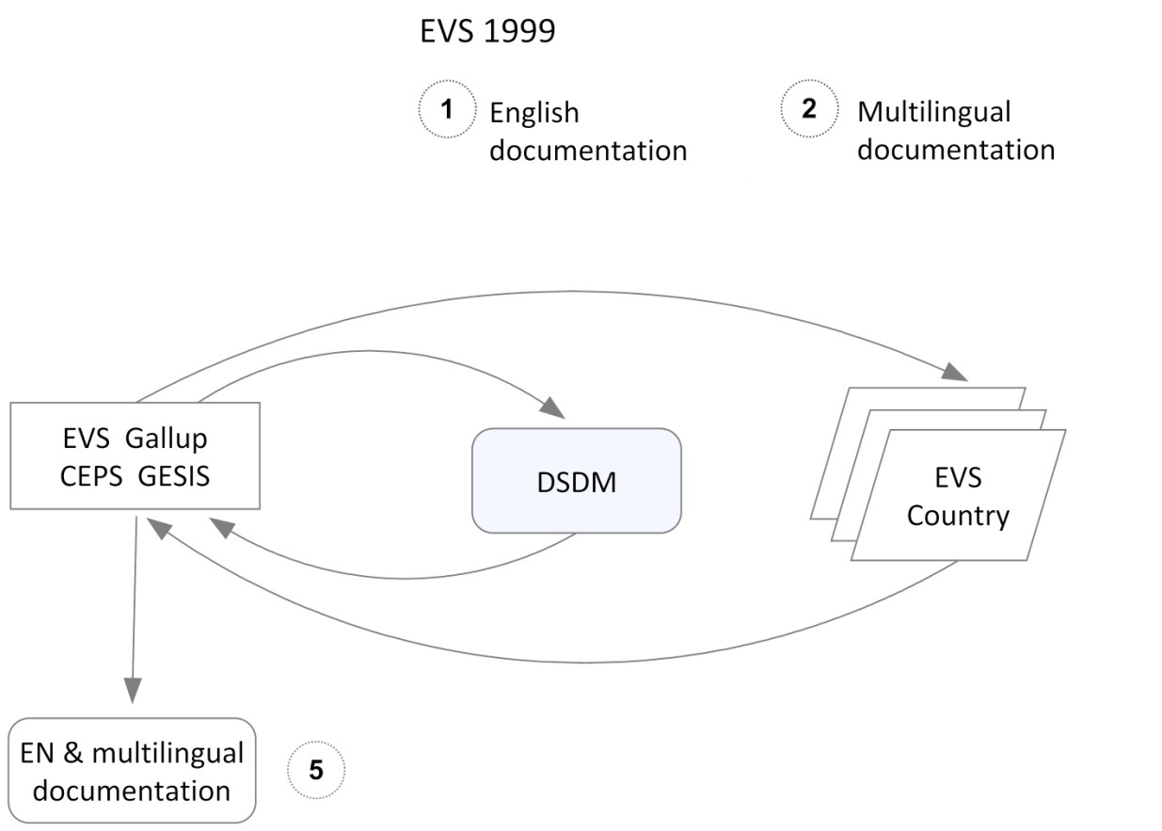
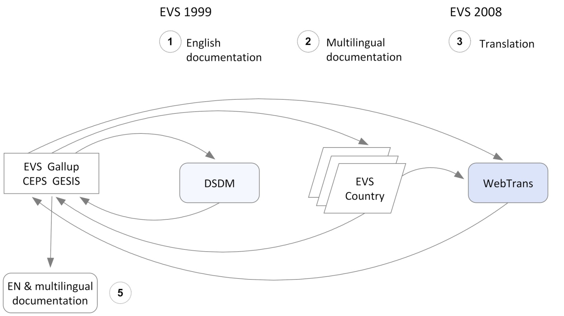
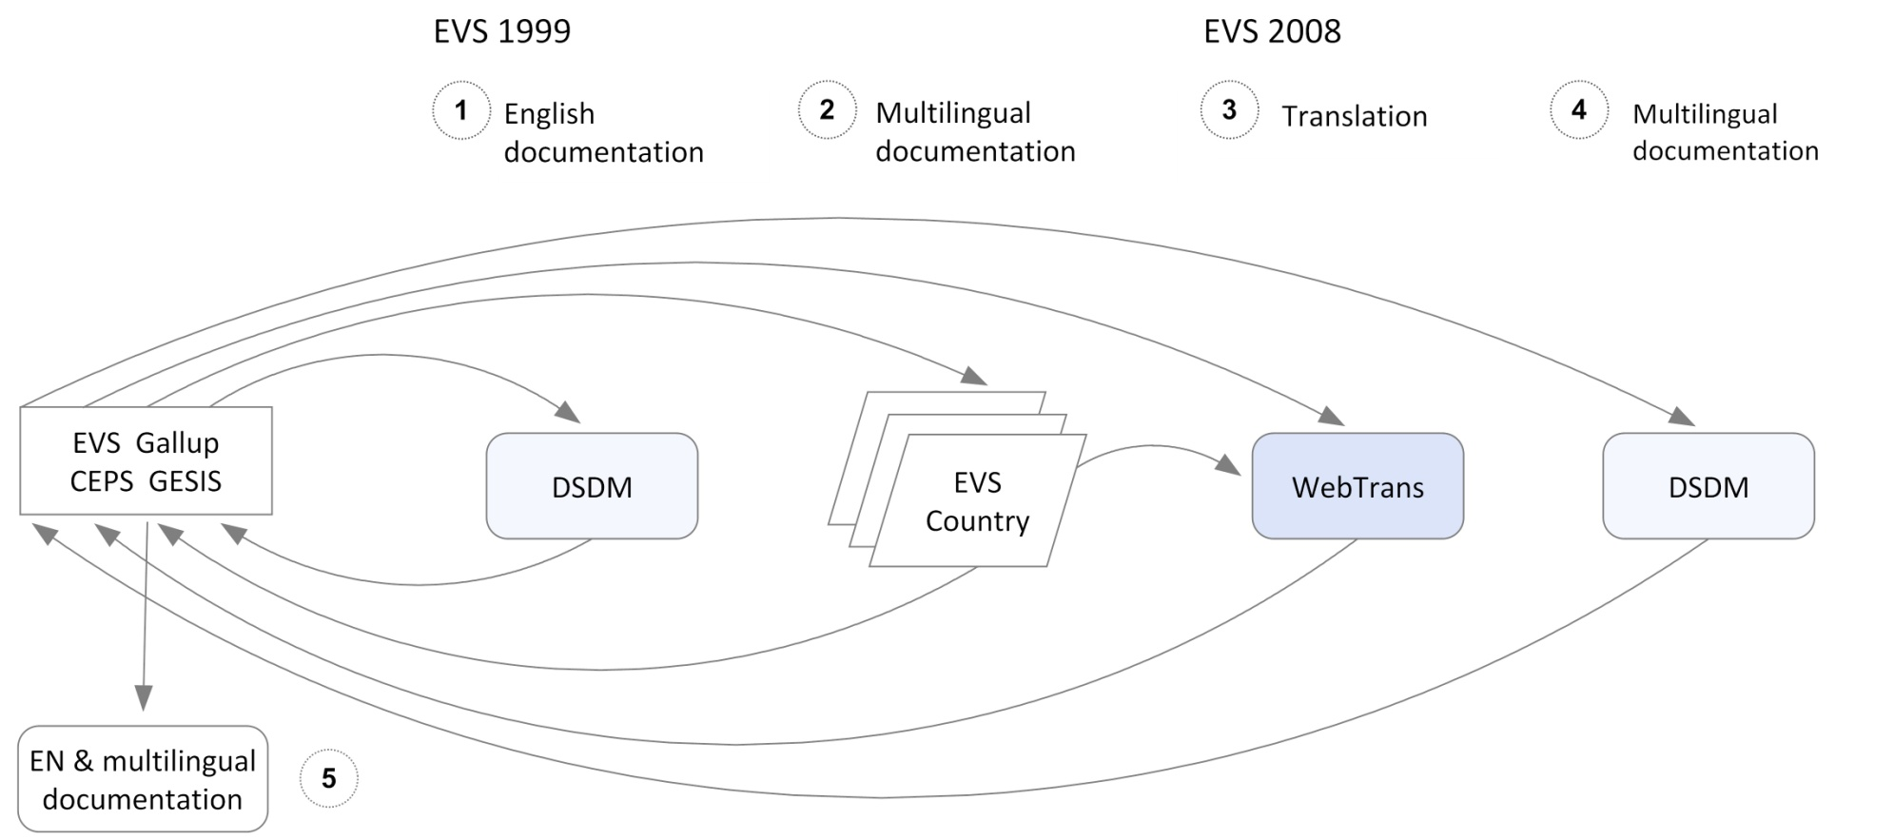
EVS 1999/2008: Translation & documentation
Notes:
10,19/22,98
1,5/6,13
The workflow covered four stages and based on the close collaboration between the EVS team at Tilburg University, the principal investigators in the EVS member countries, survey organizations, and the GESIS data archive.
The starting point was the documentation of the integrated dataset and national datasets of the 3rd wave by the English question texts. This was done by the Dataset Documentation Manager (DSDM). (The result allowed users to search for English question texts, not possible yet was a comparison of original questions. This still required the download of field questionnaires and the identification of proper questions.)
To assist comparisons of original question wording we created the multilingual documentation. Therefore, the countries were provided with a DSDM database already containing the English documentation of the national dataset. They replaced the English texts by the original question texts. (With the publication of the documentation in ZACAT it became possible for secondary users to compare the original questions across languages and countries.)
In the next step this language documentation has been used to support the translation of the questionnaire of the next wave EVS 2008. The focus was placed on establishing a centralized and well documented translation procedure. Therefore Gallup Europe provided their online questionnaire translation system - called WebTrans. All countries were asked to use the system for preparing their field questionnaires.
Three procedures were offered.
First, the review procedure for trend variables based of the original language documentation set up for the 3rd EVS wave.
Second, the new translation procedure for questions that were newly added to the master questionnaire as well as new EVS member countries and new languages.
And third, the adaptation procedure was intended for countries sharing the same language. For instance Russian had to be adapted to the cultural contexts of 8 countries.
With the WebTrans system the project pursued different goal:
- First, a controlled translation process, in which modifications of the question texts and comments of translators were documented by the system.
- Second, the export of translations as draft field questionnaires with a harmonized layout.
Third, the transfer of translations including comments back to the data archive in a suitable format.
In the last step, we again imported this translation in the data archive’s DSDM database. We checked and adjusted it, implemented a review procedure so the countries could validate the result, and finally exported it as variable-documentation of EVS 2008.
The archive workflow allows provide this variable-documentation in different output format: ZACAT, English language or bilingual variable reports and an online variable overview. This allows users to choose between the several approaches to the documentation of EVS 2008 data.

Slide 16
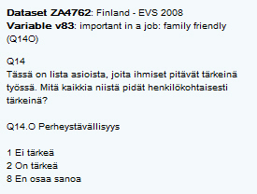
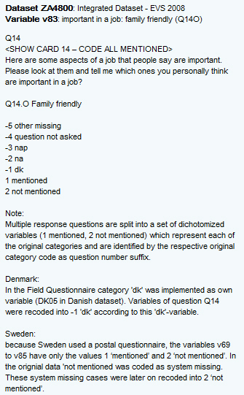
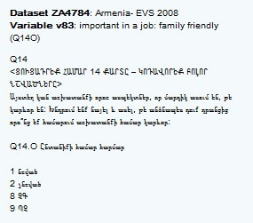
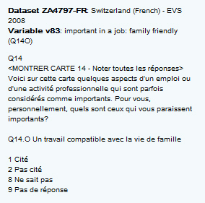
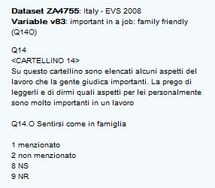
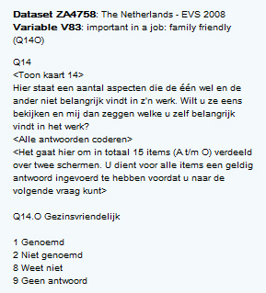
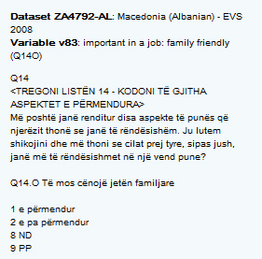
Example: ‘V83 important in a job: family friendly’
English master question
original questions
Notes:
Let me give you an example of what we mean by English and multilingual documentation of a variable.
The question asks about ‘aspects of a job that people say are important’. I have chosen item ‘family friendly’.
the English master question documented with the exact question wording, archival notes on derived variables, standards, translation problems etc., and show cards.
original questions as used in the EVS member countries. The questions presented here were asked in Armenia, Finland, Italy, Georgia, and The Netherlands. You can also see the French question used in Switzerland, or the Albanian question used in Macedonia.

Slide 17
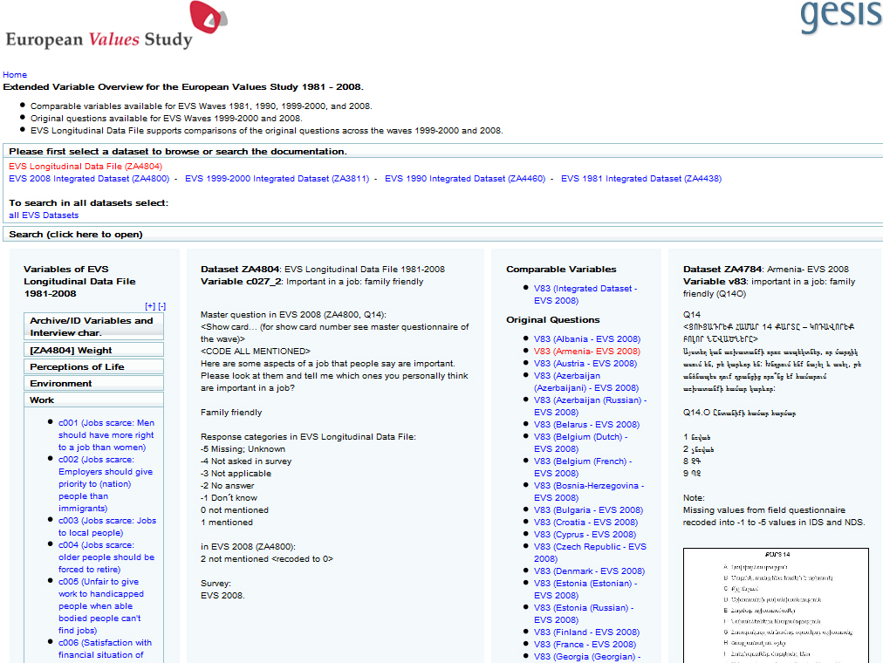
Notes:
The online variable overview is beside ZACAT another tool we provide for an easy comparison of question wording of the English master questions and the original questions.
You can select EVS 2008: all variables will be listed.
If you select a variable, the English question of item ‘important in a job: family friendly’ will be visible.
If you select a language, the original language questions will be visible.
You can also search in English documentation for variable names/labels, question texts.

Slide 18
Benefits of STARDAT
Integrative, user-optimized and intuitive user interface
Simplified import in different portals (e.g. Zacat, da|ra, DBK, etc.)
Automation of metadata management tasks (usage of scripting engine)
Support of a standardized documentation (like ISCED, ISCO)
Autocomplete and controlled vocabularies for a standardized terminology
Less different data sources and formats
Usage of re-using elements (Resource packages)
Support of Longterm preservation with DDI
→ Consistent and accelerated Archiving Workflow

Slide 19
Thank you!

