Slide 1
Metadata Driven Survey Research
Alerk Amin, CentERdata
Jeremy Iverson, Colectica
Notes:
Metadata Driven Survey Research is a way of making survey documentation an integral part of your data collection process. It can help save time and effort, reduce mistakes, and enable new services for researchers. To explain it, let me first describe exactly what I mean by metadata.

Slide 2
What is Metadata?
Data (survey data)
Metadata (data about data)
Paradata (data about process)
Notes:
Mick Couper’s Trilogy:
DATA – survey data, either raw or cleaned.
METADATA – info about the data collection, such as question texts, calculations used to clean variables, concepts studied, and more
PARADATA – extremely important. Look into more detail

Slide 3
Paradata
Empirical measurements about the process of creating survey data
Paradata is data
Notes:
Paradata examples:
Timestamps/keystroke files
Respondent observations about the data collection
CAPI: observations of interviewers, data about interviewer
CAWI: browser version, mouse tracking
Paradata is therefore just more data, and also needs metadata to describe it.
Types of Paradata:
visual observations of interviewers
administrative records about the data collection process
computer-generated measures about the process of the data collection
external supplementary data about sample cases
observations of respondents themselves about the data collection

Slide 4
Metadata
DATA
Survey data
Metadata
Paradata
Notes:
For the purposes of this presentation, “DATA” includes both survey data from respondents, as well as paradata. Metadata will be used to describe both kinds of data.

Slide 5
Why is Metadata Important?
“Survey documentation and metadata are vital products of a survey and need careful consideration at the point of survey design so that the data will be useful.”
From Survey Methodology, by Robert M. Groves, Floyd J. Fowler, Mick P. Couper, James M. Lepkowski, Eleanor Singer
Notes:
Need good metadata to understand the data

Slide 6
AER Data Availability Policy
“It is the policy of the American Economic Review to publish papers only if the data used in the analysis are clearly and precisely documented and are readily available to any researcher for purposes of replication.”
Notes:
Documentation is important to users of Survey data, including researchers from other fields.
AER – the top Economics journal – requires documentation for purposes of replication

Slide 7
“Current” Situation
Notes:
Let’s look at the “normal” workflow at many survey research organizations

Slide 8
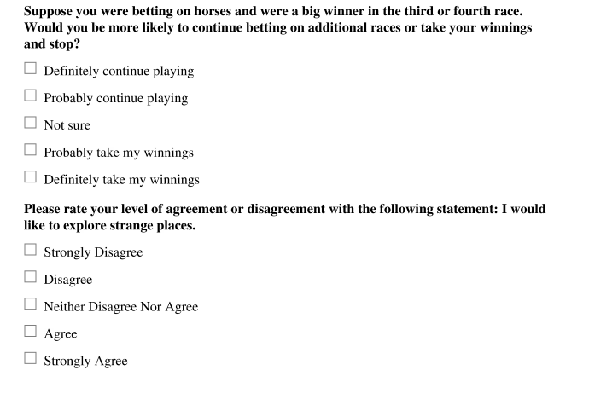
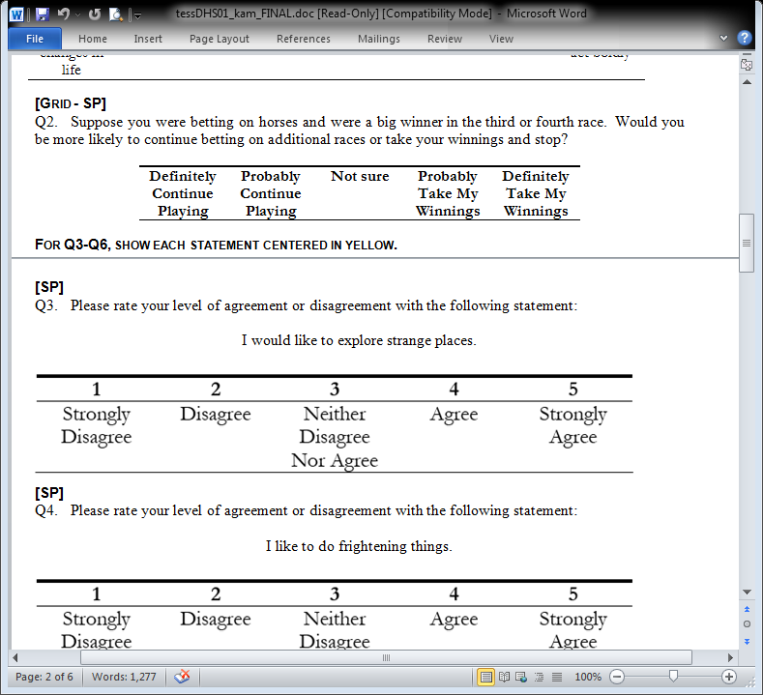
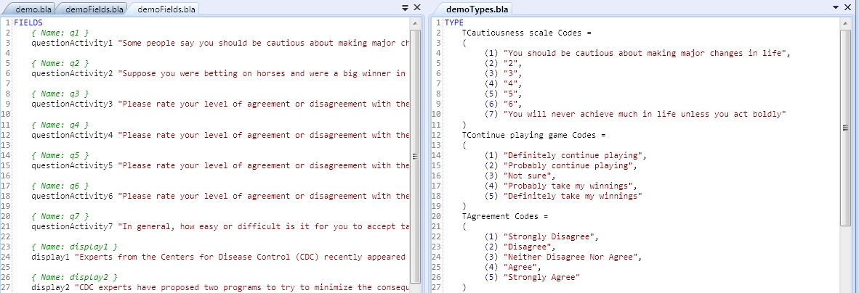
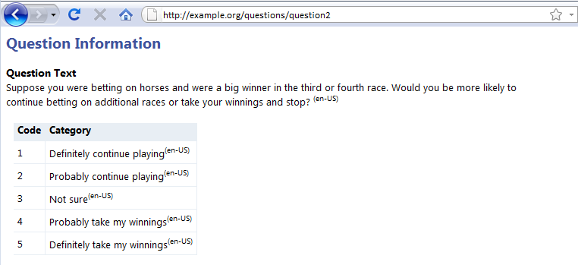
Questionnaire Development
Notes:
[Animated slide. 4 Images appear one at a time, overlapping.]
Let’s take a look at a typical questionnaire development process.
[Image 1] We might start with a Word or Excel document. At first it looks like this might be a paper survey, but if you look closely it actually includes instructions, like “show each statement centered in yellow”. So it’s more of a specification that a researcher wrote as they were creating the questionnaire.
[Image 2] So the researchers is writing this survey specification, and they might pass it onto a programmer who will write some source code. In this case it’s in Blaise.
[Image 3] The researcher might also send the survey off to a designer to create a paper form that can be mailed to respondents.
[Image 4] And finally we might put the questionnaire up on the web as a form of documentation for other researchers.
Looking at one of these questions, how many times have we written it? In this case four, but it could easily be more in a real world situation.
This might not be a big deal if the survey is 10 or 20 questions long. But if you’re dealing with a survey that has hundreds or thousands of questions, administered via phone, mail, and web, and that’s repeated every year, you’re talking about a serious amount of effort and a huge potential for error.
Additionally, the decisions made by each person in the process don’t end up in the final survey documentation.
Now, let’s look at this in the context of the larger process

Slide 9
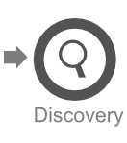
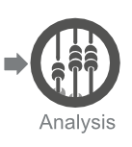
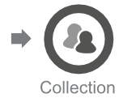
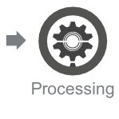
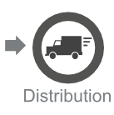
The Data Lifecycle
Documentation
Lost
Notes:
[Animated slide. Each icon appears in order and the stage is described. Then the colored overlay rectangles appear to indicate which parts are generally documented.]
Let’s see how this might apply to the data-driven research process. This is the data lifecycle as modeled by DDI.
At the beginning the researcher has an idea they want to study. This is the conceptual stage.
Then they design a way to collect data they can use to study the idea, and they collect the data. This includes survey design, implementation, fieldwork, etc.
Usually there is some processing that goes on before …
… the data is distributed to researchers for analysis
Of course the researchers need to discover the data relevant to their research interests
Once they get some data they perform their favorite analyses,
And this may involve a bit of repurposing
And somewhere along the line the data may be deposited in an archive
What parts of this process are usually documented?
Generally documentation happens when the data is put out for distribution and when it’s archived.
That means all these other stages are undocumented, even though there’s a lot going on.
The idea of metadata driven survey design is that by documenting the process from the beginning …
[Reveal blue over the beginning stages]
We can shed light on much more of the data lifecycle.

Slide 10
A Better Solution
Metadata-Driven Survey Research

Slide 11
Metadata Driven Survey Research
Metadata
Survey instruments
Paper questionnaires
Statistical source code
Paper documentation
Web documentation
Notes:
The idea is that you start with the metadata: the questions and logical flow of the survey. If the metadata is well defined and in a structured format, it becomes possible to automatically generate:
Survey instruments source code
Paper questionnaires
Statistical command files
Paper documentation
Web documentation
And anything else you might need for your process
By metadata, I mean things like the questions that make up a survey, the classification systems, survey instruments, and descriptions of analysis variables and datasets. We’ll get into those details in a bit.
The key is that the metadata is defined just once.
Generate these things by clicking a button. Not by re-entering things for each medium.

Slide 12
Questionnaire Development
Better, faster, cheaper
Eliminate cut-and-paste from Word/Excel
Automate more of the process
Metadata reuse saves even more time and effort for longitudinal surveys

Slide 13
Survey Documentation
Integral part of process
Easier to capture work done by all people/agencies in data collection process
Notes:
Fulfills recommendation from Survey Methodology book.
Survey documentation no longer becomes a “cost” during the distribution step of the data lifecycle.

Slide 14
Metadata Repositories
Leverage metadata both inside & outside organization
Allows for
Concept Banks
Question Banks
Variable Banks
Classification Banks
Link to other repositories when reusing questions
Notes:
Structured metadata can easily be published in metadata repositories.

Slide 15
Researcher Questions
What studies explore these concepts?
What questionnaires use this question?
What datasets have this variable?
Notes:
A metadata repository allows researchers to better discover and understand the data.
And it shouldn’t necessarily take a human to find the answer to these questions. A metadata repository can be machine actionable, so you can write structured queries or programs to ask these questions and find the answers.

Slide 16
Increased Understanding
Improved discoverability
Improved comparability
Researchers understand more of data collection process

Slide 17
How to do this?
It’s possible today

Slide 18
DDI 3
Documents all stages of data lifecycle
Defines elements and relationships
Designed for reuse of elements
Provides structured method of describing additional data
Geographic data
Medical data
Biomarker data

Slide 19
DDI Workflow
Define the metadata and relationships
Automate everything else
Notes:
DDI provides the framework
- Define the metadata and the relationships
- Automate everything else with a tool
DDI lets us formally document
Studies
Concepts
Universes
Classifications
Questions
Survey Instruments
Variables
Datasets
A whole lot more

Slide 20
DDI 3 Tools
Colectica
Questasy
Canada RDC Tools
STARDAT
Custom tools
DDA Metadata Editor
Notes:
There are many tools available to help you put this into practice.

Slide 21
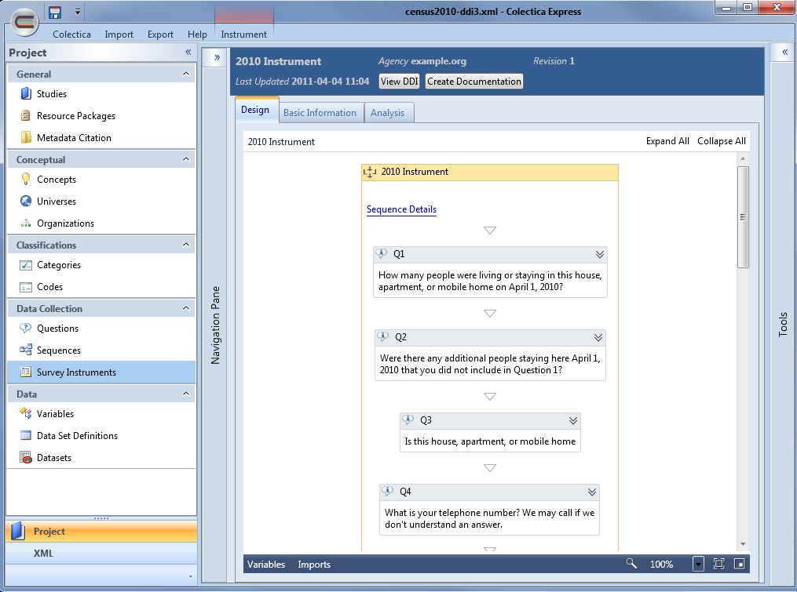
Colectica

Slide 22
Questasy

Slide 23
DDA Metadata Editor

Slide 24
Thank you
Alerk Amin
a.amin@uvt.nl
Jeremy Iverson
jeremy@colectica.com

