Slide 1
DDI and the Lifecycle of Longitudinal Surveys
Larry Hoyle, IPSR, Univ. of Kansas
Joachim Wackerow, GESIS - Leibniz Institute for the Social Sciences

Slide 2
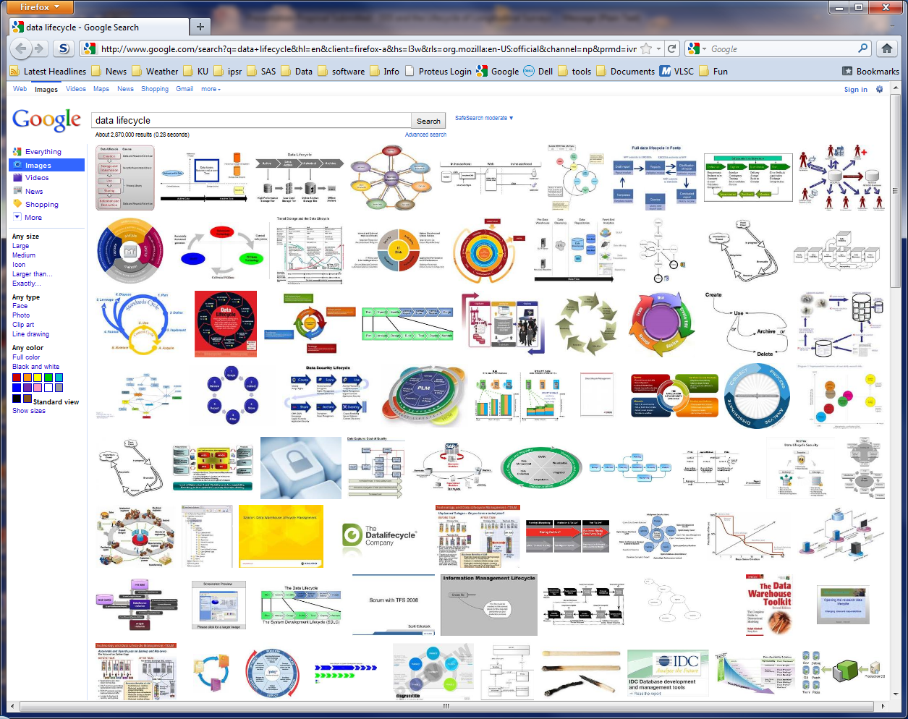
Google Images Search: "Data Lifecycle"

Slide 3
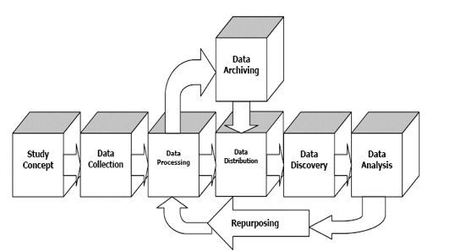
DDI View – (Cross-sectional Study)

Slide 4
Longitudinal Studies Modify this View
The cycle will repeat
Any stage may influence another
E.g. analysis may lead to reconceptualization
Archiving may be done at multiple points
E.g. to preserve the state of data as of publications

Slide 5
An Extended Time Frame
Things change over time
Procedures
Measures
Populations
Staff
External events
Laws
Documenting these is important for data use, interpretation, and critical for study replication.

Slide 6
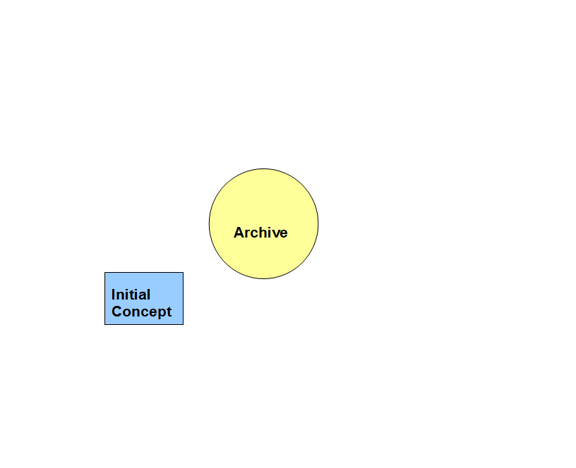
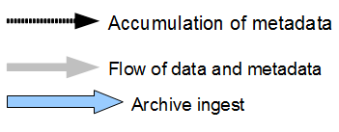
A study is born

Slide 7
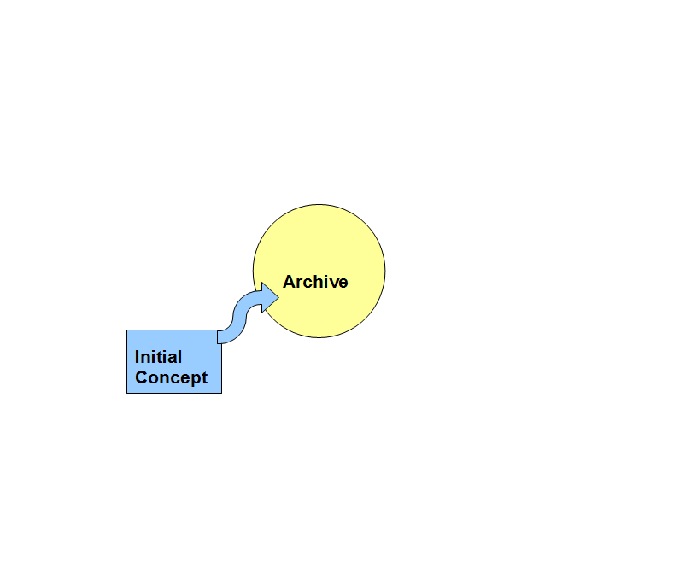
Checksum of Study Design Document Could be Archived

Slide 8
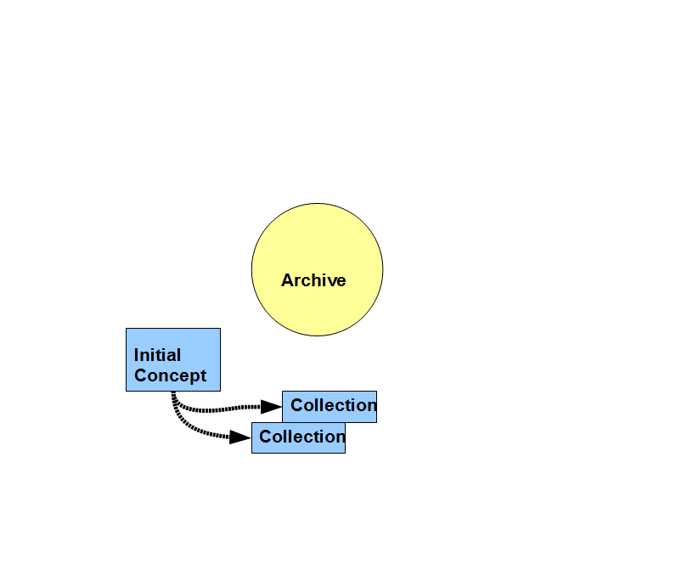
Multiple Collection Processes Begin

Slide 9
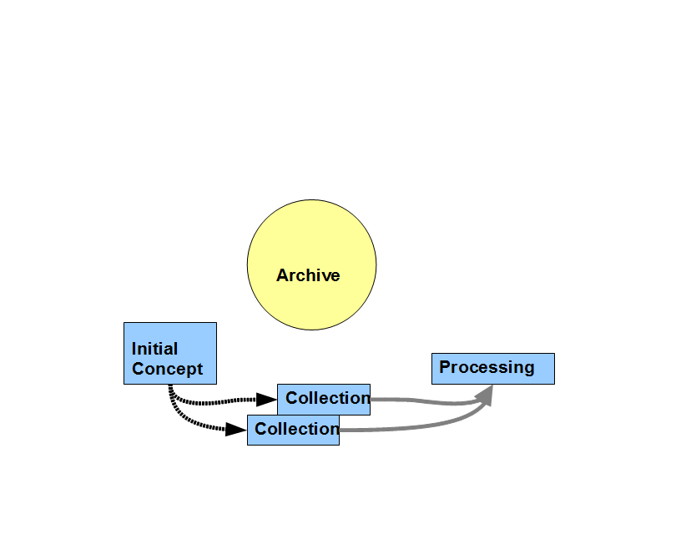
Processing – (e.g. Data Cleaning, Restructuring, Recoding)

Slide 10
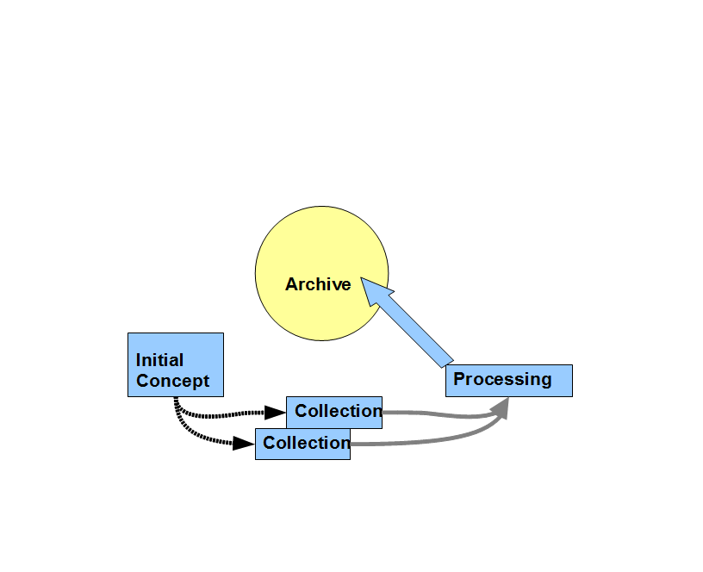
Initial Data are Archived

Slide 11
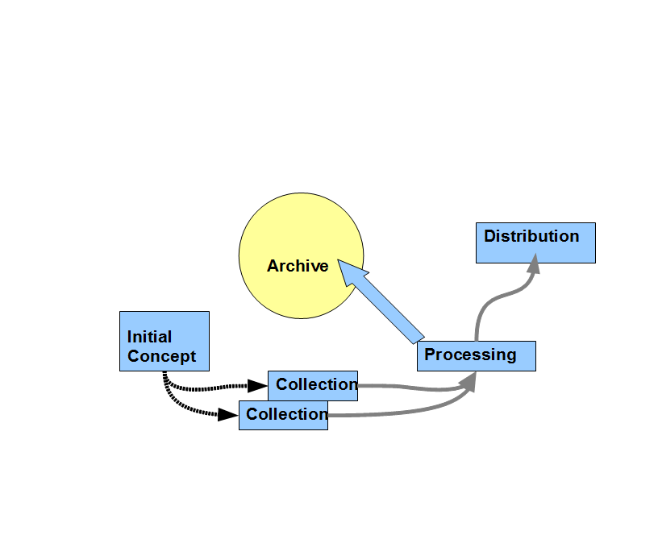
Initial Distribution

Slide 12
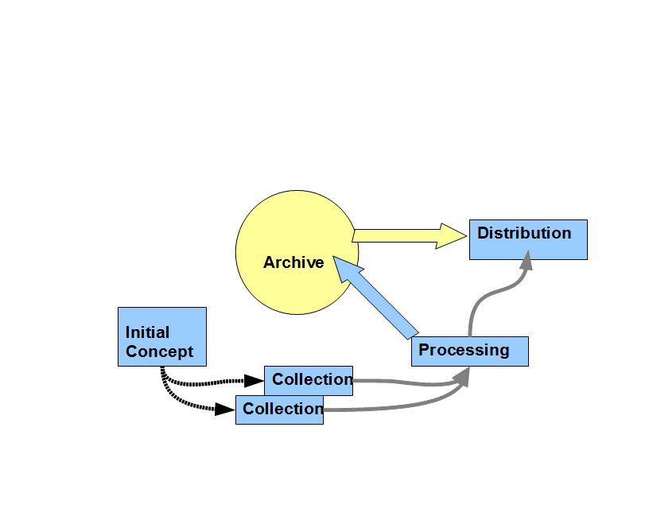
Initial Distribution – Possibly From Archive

Slide 13
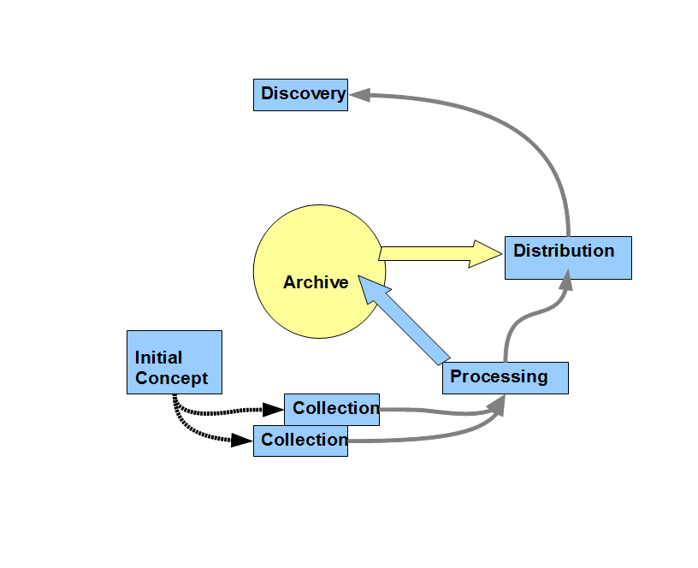
Initial Data Discovery

Slide 14
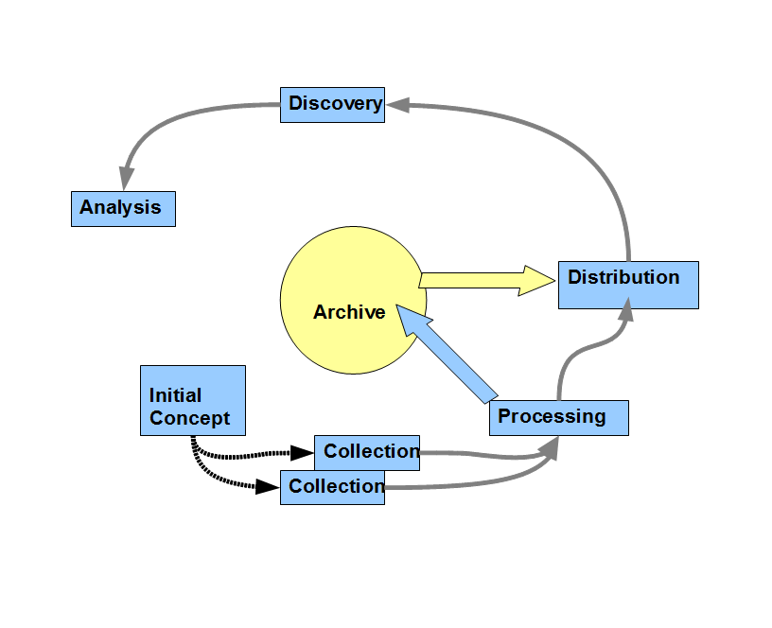
Initial Data Analysis

Slide 15
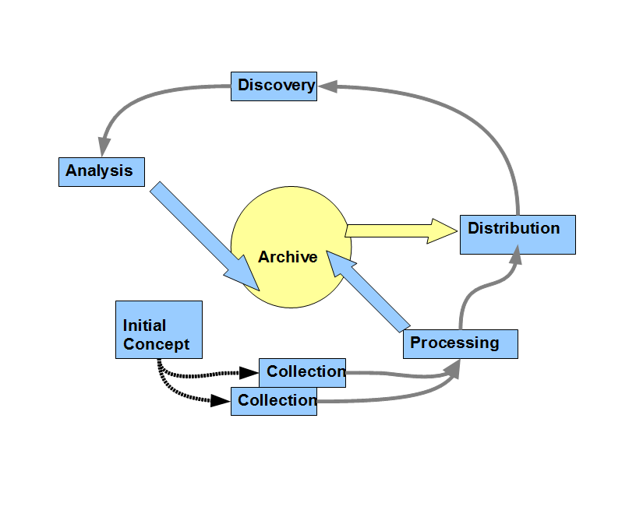
Initial Data Analysis and Data Archived

Slide 16
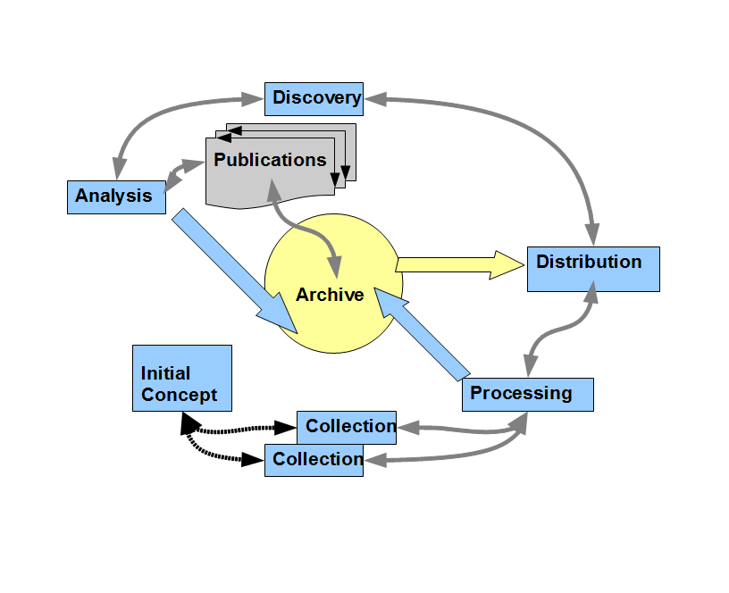
Publications – Reference and Referenced by Archive

Slide 17
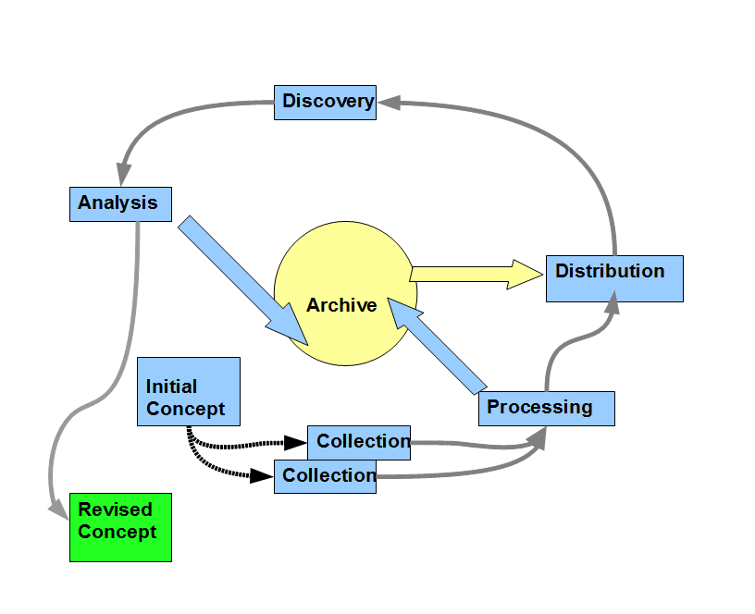
SECOND WAVE – Revised Concept

Slide 18
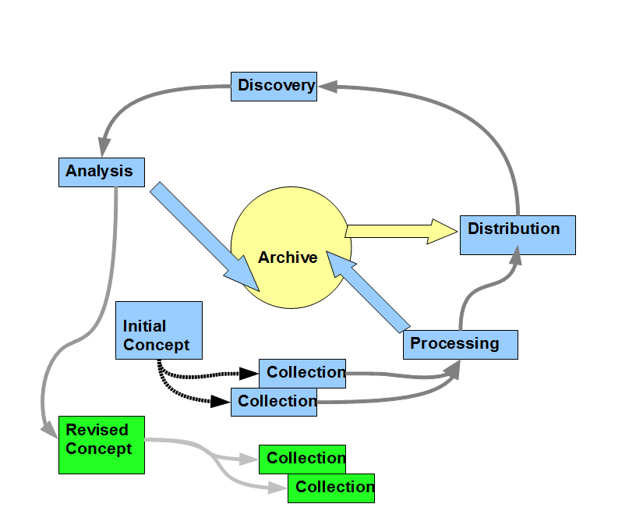
SECOND WAVE – Data Collection

Slide 19
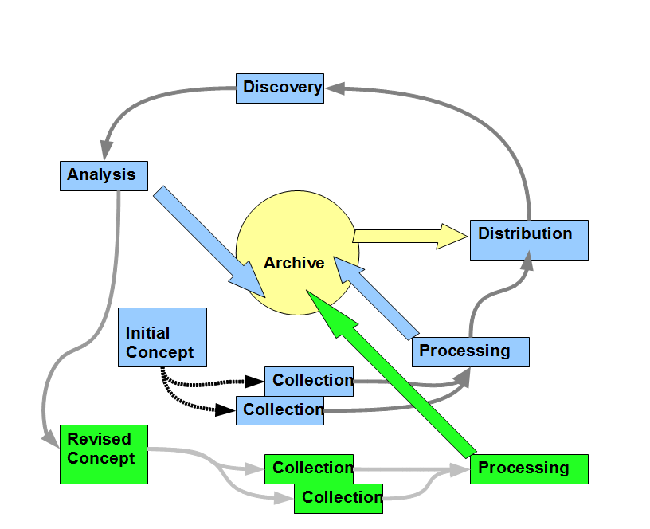
SECOND WAVE – Data Processing

Slide 20
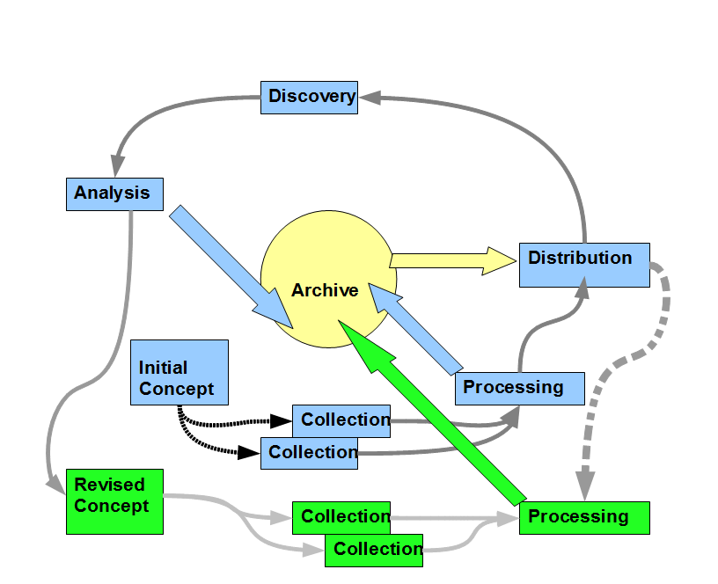
SECOND WAVE – Processing Uses Feedback from Stage 1
Here something learned in the initial distribution affects future processing. This should be recorded.

Slide 21
SECOND WAVE – Processing Uses Feedback from Stage 1
These metadata flows may happen between many stages, e.g. from processing to later collection.

Slide 22
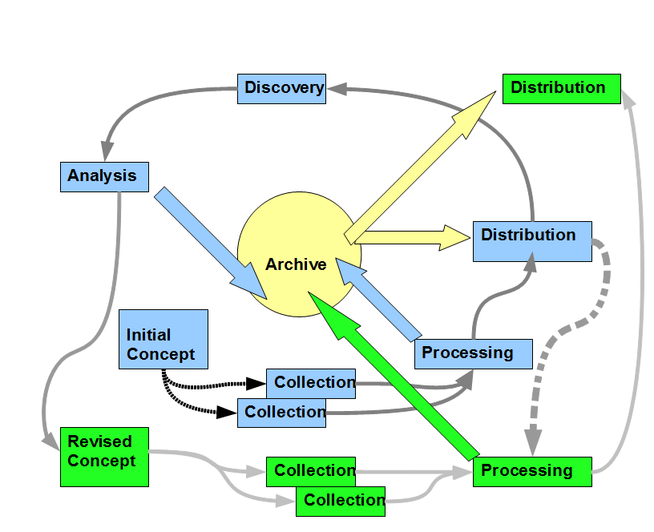
SECOND WAVE – Distribution

Slide 23
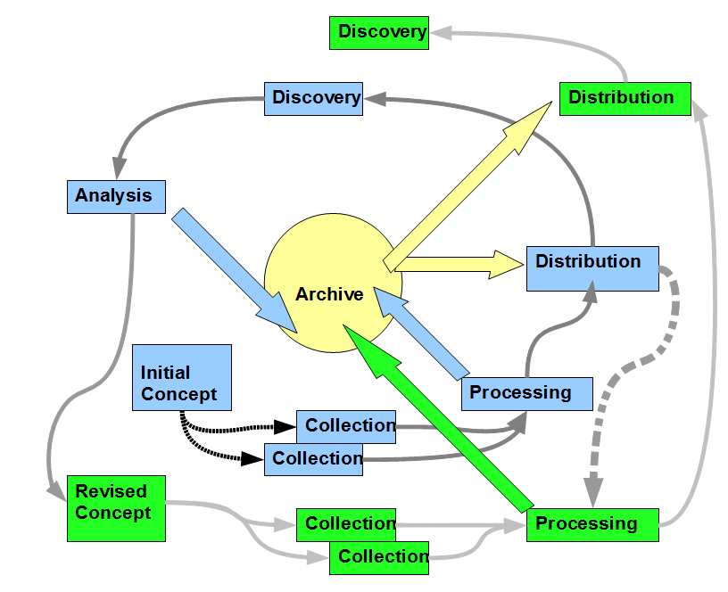
SECOND WAVE – Discovery

Slide 24
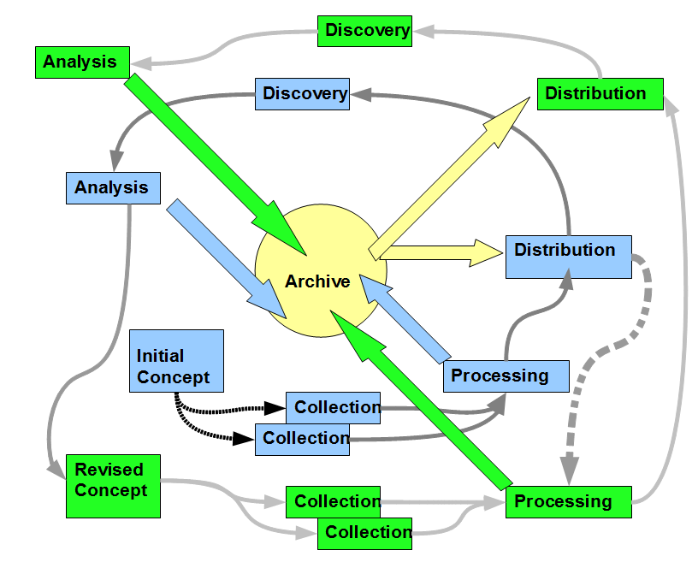
Final Analysis Archived

Slide 25
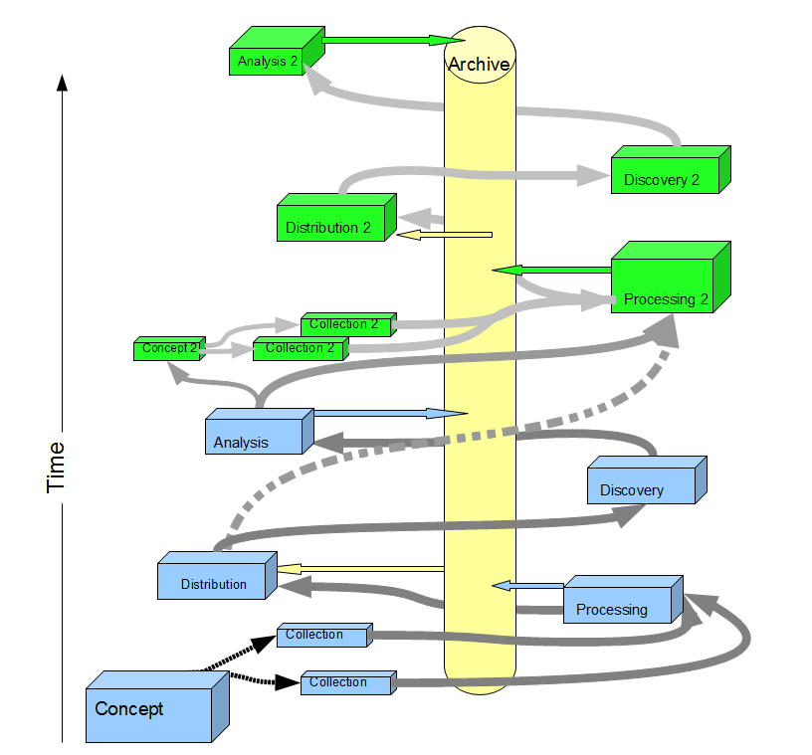
A Kansan's Cyclone View

Slide 26
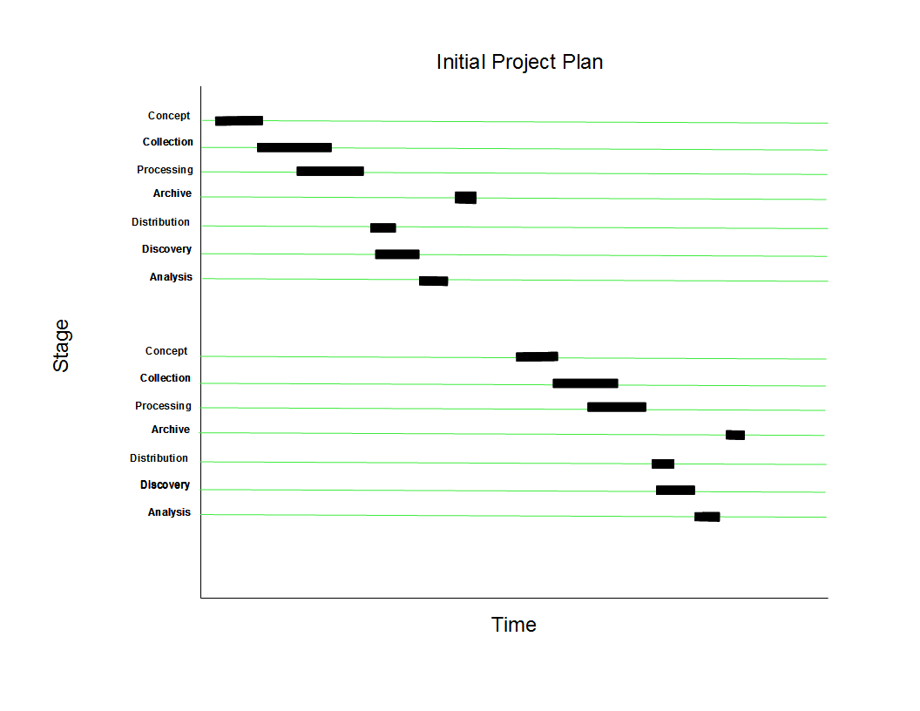
Gantt View – Initial Design

Slide 27
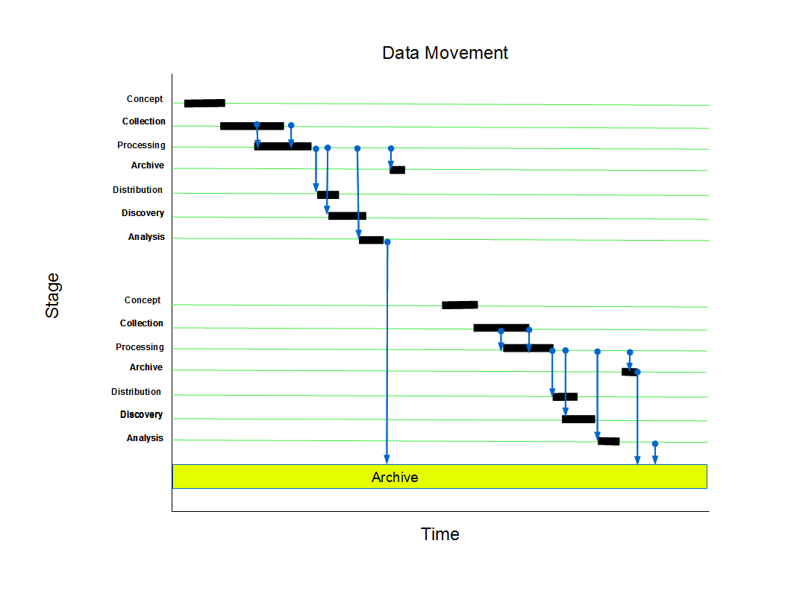
Gantt with Data Flow (Blue)
Much of this movement of data between stages is planned from the beginning of the project

Slide 28
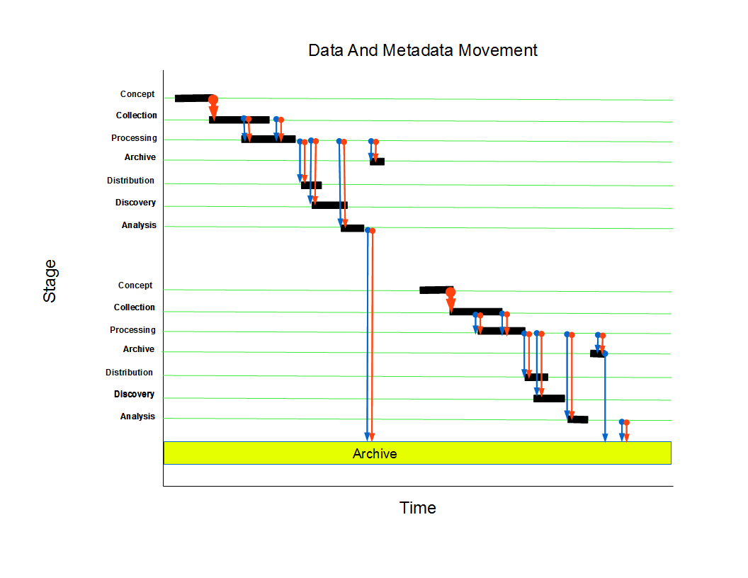
Gantt With Planned Data and Metadata Flow
Metadata are generated as data move through the project, as well as before any data are gathered.

Slide 29
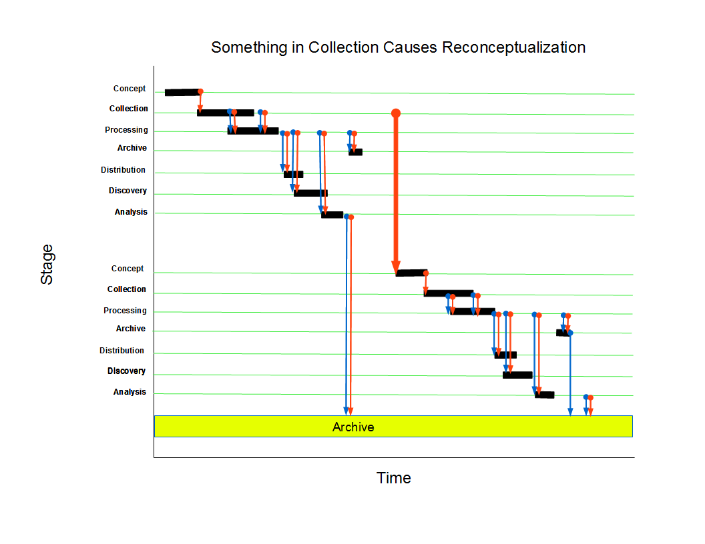
Gantt – Collection Changes Project Concept
Some metadata are unanticipated. Here something learned during the first collection phase causes a reconceptualization

Slide 30
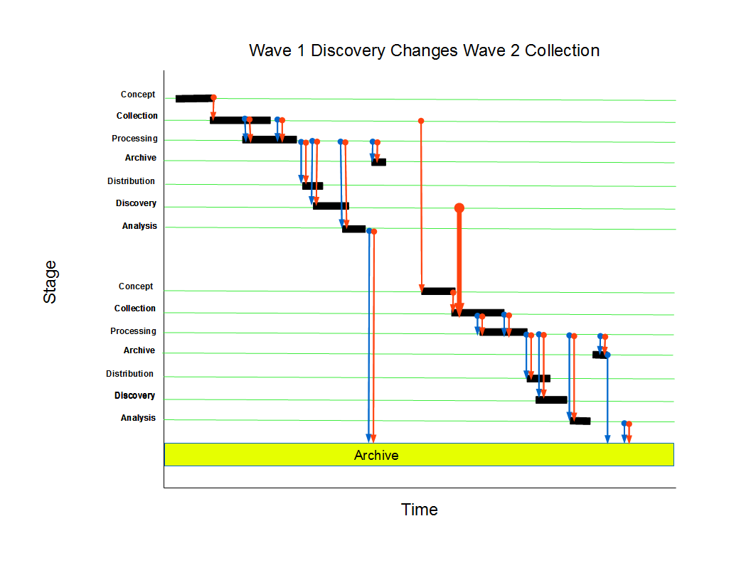
Gantt – Discovery Changes Future Collection
Here something learned during discovery changes future collection

Slide 31
DDI Features for the Lifecycle in DDI Lifecycle (DDI 3 Branch)
Metadata structure
Machine actionable: drive research, automate reuse
Comprehensive description, including external aids to data collection (e.g. audio, video), sampling
Resource Package
Reusable elements
Documented comparability
Comparison
Documents similarities and differences
Lifecycle Events

Slide 32
DDI Features for the Lifecycle
Series
Relationships among waves
Versioning
Because we know things change
Access Controls
Control Constructs (Questionnaire Flow)
Summary Statistics
Embedded Data

Slide 33
Metadata Structure
Generate survey instruments, samples
Iverson and Amin Metadata Driven Survey Design
Administer Surveys
E.g. DDI <-> Blaise, CASES, CSPro
Tables and graphs
Automated data import

Slide 34
Resource Package (i.e. study-independent information)
Reuse of elements by reference
Harmonization across waves, studies
Versioning and Comparison elements
Documents changes
Facilitates harmonization efforts

Slide 35
Comparisons
Commonality and difference between
Concepts
Variables
Questions
Categories
Codes
Universes (survey population)

Slide 36
Lifecycle Events
Recording events internal and external to the project aids in interpretability.
Internal examples
Staff changes
Procedural changes
External events
Major political or economic events, natural disasters

Slide 37
Other Resources
Dagstuhl Workshop on "Best Practices for Longitudinal Data", 2010
http://www.ddialliance.org/resources/publications/working/BestPractices/LongitudinalData
Inclusion of non-survey data e.g. biomarkers
Comparison
Presentation

Slide 38
Representing Longitudinal Data in DDI (Extract)

Slide 39
http://www.ddialliance.org/

